Slide 1
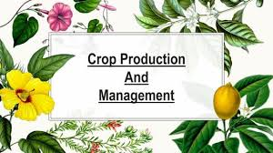
Crop Production and Management
M.ANURADHA
BIOLOGY

Slide 2
PREVIOUS KNOWLEADGE
Why Kharif crops cannot be grown in Rabi season?
What are the steps involved in soil preparation?
Name the medium in which plants grow.
Why is it necessary to dry grains before storing them?
How are manures prepared by the farmers?
What are the basic practices of crop production?
What are crops? Explain the two crops in detail.
Write a short note on weeding.
Explain how fertilizers are different from manures?
Give examples of two Rabi and two Kharif crops.
Explain modern method of sowing.
What is crop rotation and why is it important?
How are grains stored and protected?
Mention names of any two fertilizers.
Why is it necessary to sow seeds at appropriate depth?

Slide 3
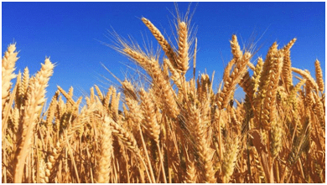
INTRODUCTION
Crop production is cultivating plants on a large scale to provide food, fiber, and other essential resources for human consumption and industrial use. Crop management, involving various farming practices, is crucial to ensuring high yields, superior quality, and long-term sustainability.

Slide 4
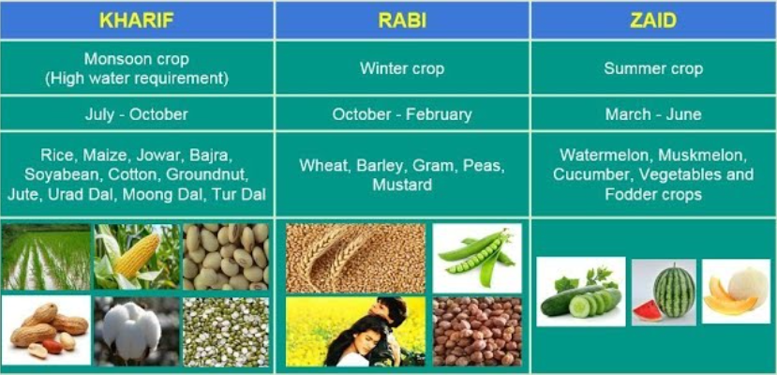
TYPES OF CROPS
Crops
Plants of the same kind which are grown and cultivated at one place on a large scale are known as crops. Different types of crops require different climatic conditions like temperature, humidity and rainfall. Crops are divided into two main groups on the basis of growing season.
Kharif crops : These crops are sown in the month of June/July and harvested in September/October every year. e.g. Paddy, maize, sugarcane, sorghum (Jowar), pearl millet (Bajra).
Rabi crops : These crops are sown in the months of October/November and harvested in March/April every year. e.g. Wheat, oat, barley and pea.

Slide 5
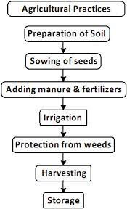
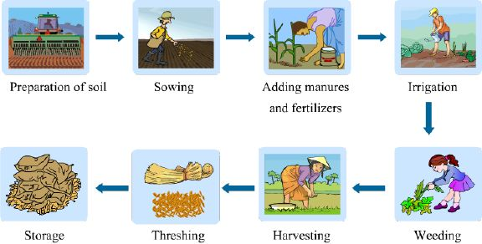
AGRICULTURAL PRACTICES

Slide 6
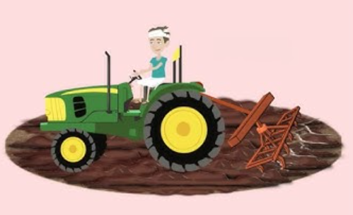
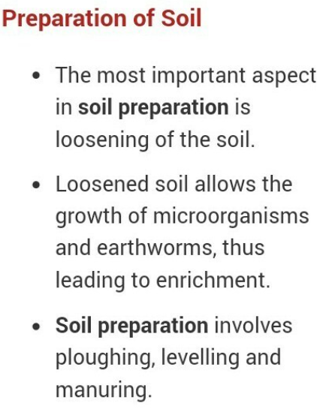
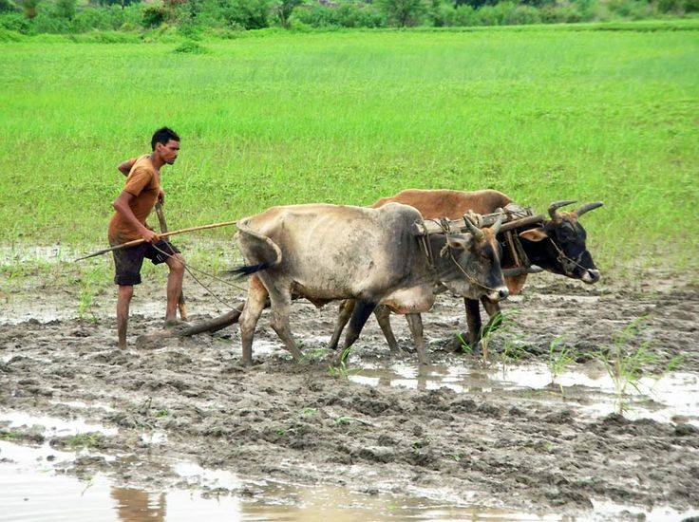
PREPARATION OF SOIL

Slide 7
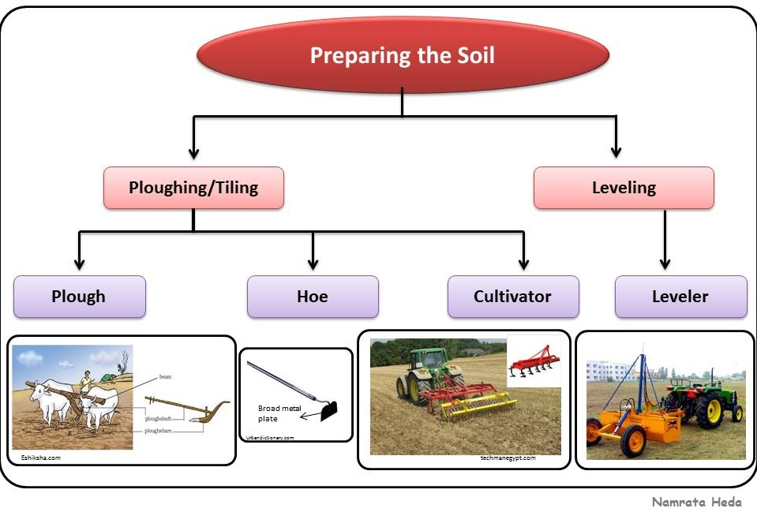

Slide 8
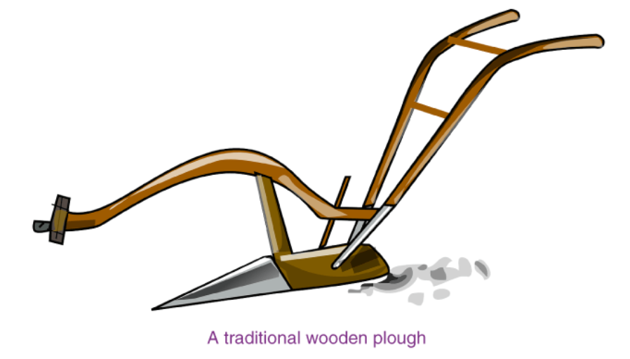
Tilling or Ploughing
The process of loosening and turning of the soil is called tilling or ploughing and is done by using a plough.
Plough
A plough is a device that is used by farmers for different purposes, such as adding fertilizers, tilling and loosening the soil.
It is also used for adding fertilizers to the soil, removing weeds, scraping of soil, etc.
The ploughshare is the triangular iron strip.
A plough shaft is the main part of the plough, which is made using a log of wood.
The other end of the shaft has a handle.
The other end is attached to a beam which is placed on the bull’s neck.
A wooden, traditional plough can be operated by a pair of ox and a man.
Nowadays, these wooden ploughs are being replaced by iron ploughs.

Slide 9
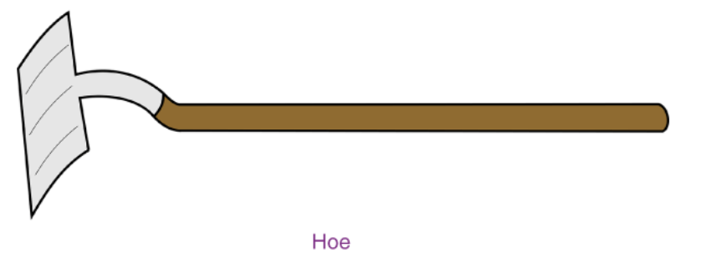
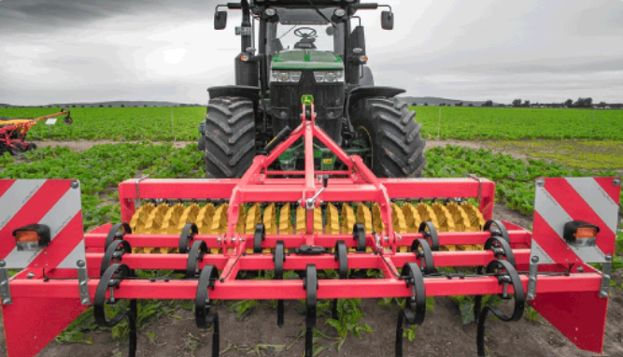
Hoe
A hoe is a tool that is used to dig up soil to remove weeds and also loosen up the soil before planting a sapling.
Cultivator
A cultivator is attached to the tractor and helps in loosening soil.
Cultivators are used instead of ploughs since they are faster.

Slide 10
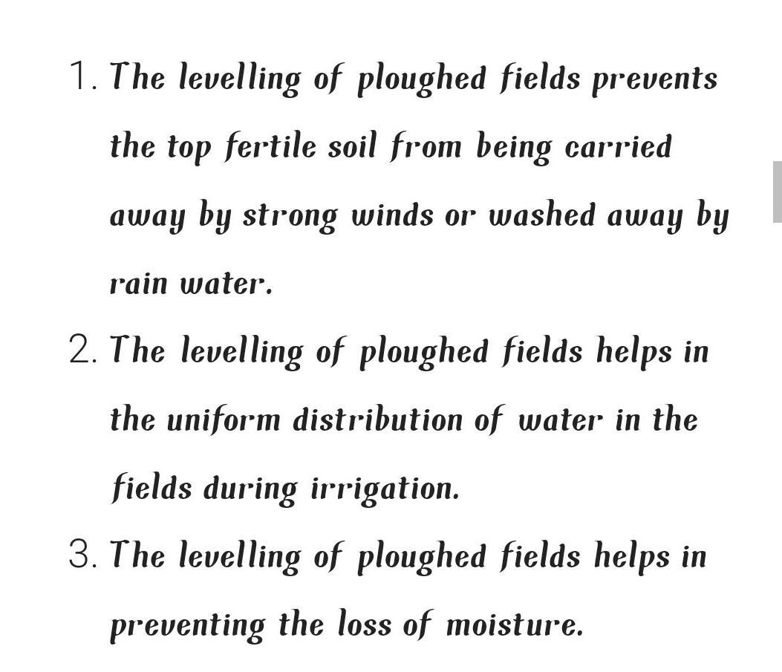
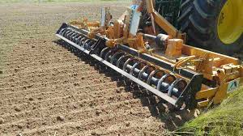
LEVELLING OF SOIL

Slide 11
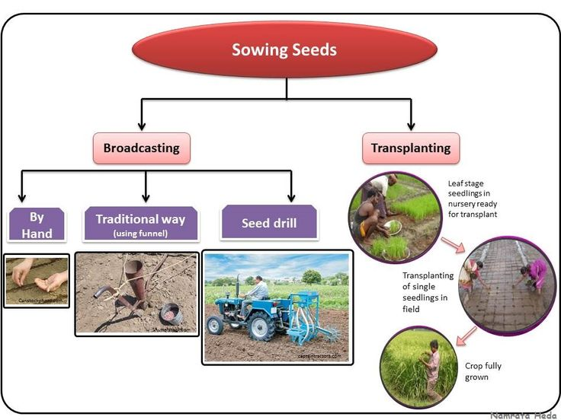

Slide 12
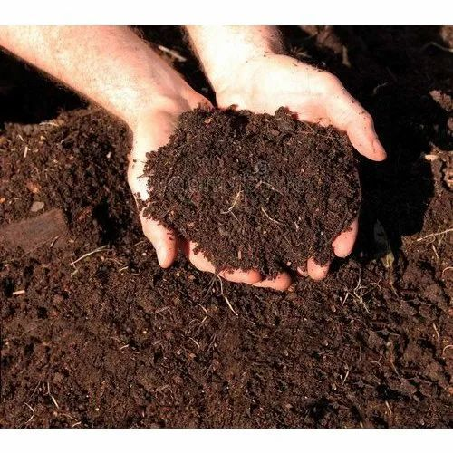
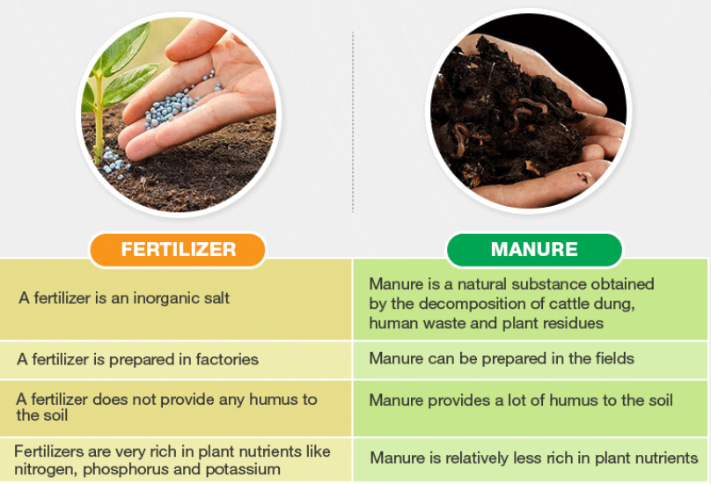
MANURE AND FERTILIZER

Slide 13
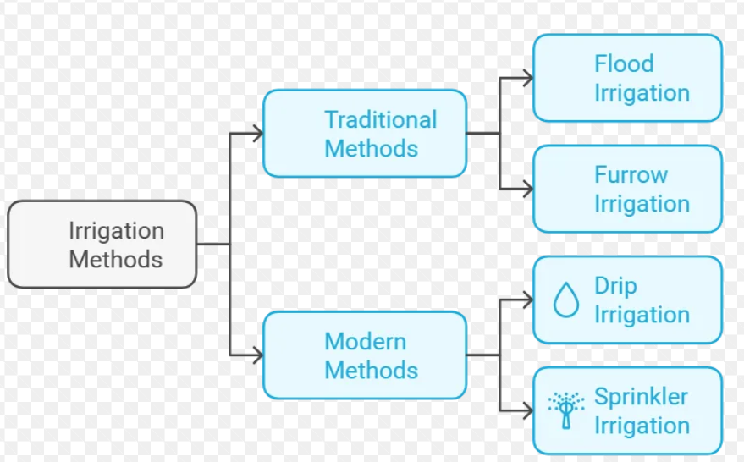
IRRIGATION
Irrigation is the process of applying water to the crops artificially to fulfil their water requirements. Nutrients may also be provided to the crops through irrigation. The various sources of water for irrigation are wells, ponds, lakes, canals, tube-wells and even dams.

Slide 14
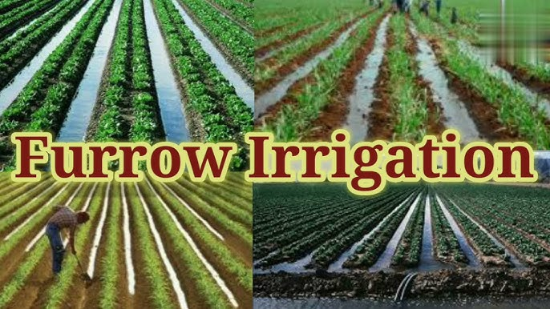
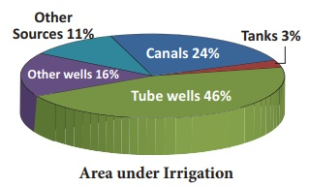

Slide 15
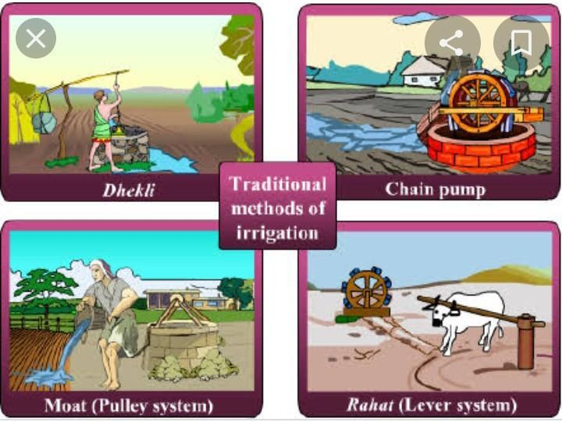
TRADITIONAL METHODS OF IRRIGATION

Slide 16
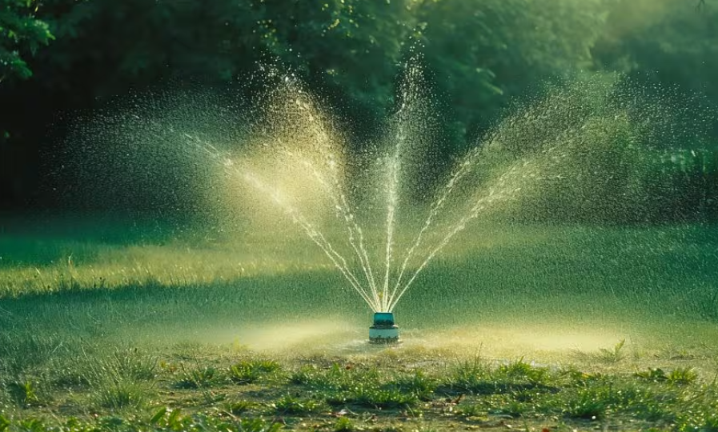
SPRINKLER SYSTEM
Sprinkler system: In the Sprinkler irrigation method the water is sprayed or sprinkled over the land to be irrigated. The water is distributed through the system of pipes by pumping. It is then sprayed into the air with the help of sprinklers, which breaks up into small water drops and falls to the ground. The pump supply system, sprinklers, and other operating conditions are designed to enable uniform distribution of water.

Slide 17
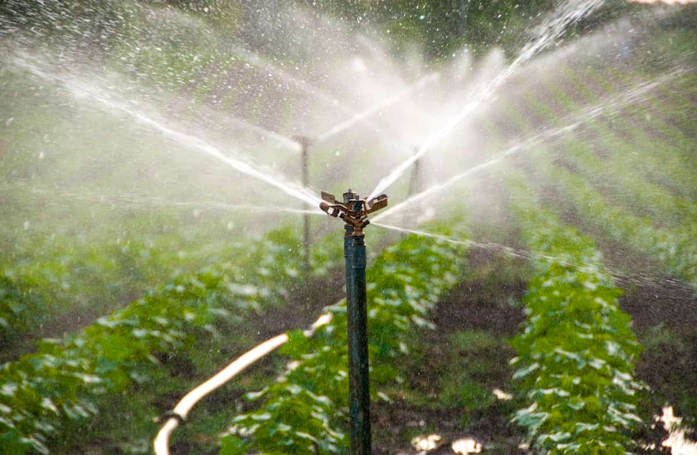
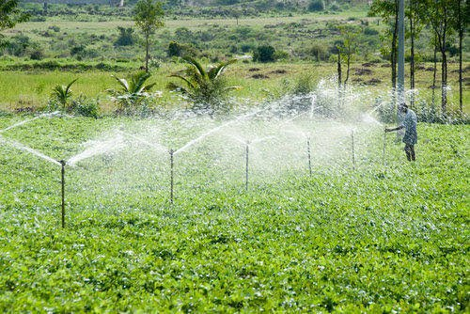

Slide 18
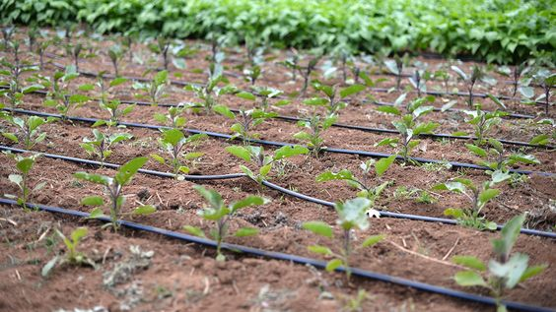
DRIP IRRIGATION SYSTEM
Drip system: Drip irrigation is the most efficient water and nutrient delivery system for growing crops. It delivers the water and nutrients directly to the plant’s roots, in the right amounts, at the right time, so each plant gets exactly what it needs, when it needs it, to grow optimally. The farmers can produce higher yields while saving on water as well as fertilizers, energy, and even crop protection products.

Slide 19
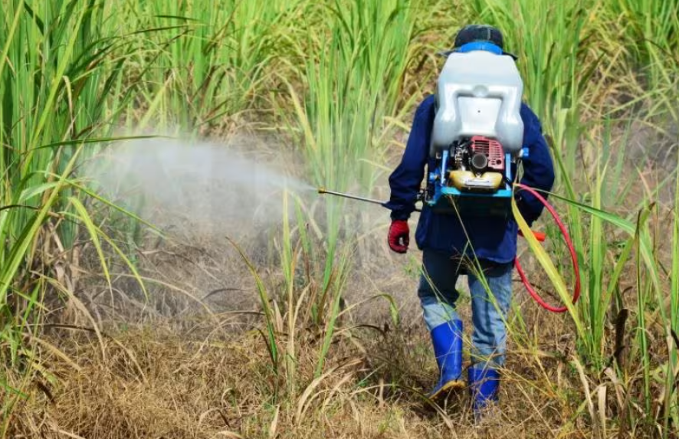
WEEDS
Weeding
Removal of weeds or undesirable plants is called weeding. It can be done by a kurpai (trowel) and a harrow.
Weed : They are unwanted plants which grow along with a cultivated crop in a field. They can severely reduce crop yields by competing for light, water and nutrients.
Some weeds interfere in harvesting and may be poisonous for animals and human beings.
Some common weeds : Parthenium (Gajar grass), Convolvulus, Amaranthus (Chaulai), Chenopodium (Bathua), Xanthium (Gokhroo) and Dandelions.

Slide 20
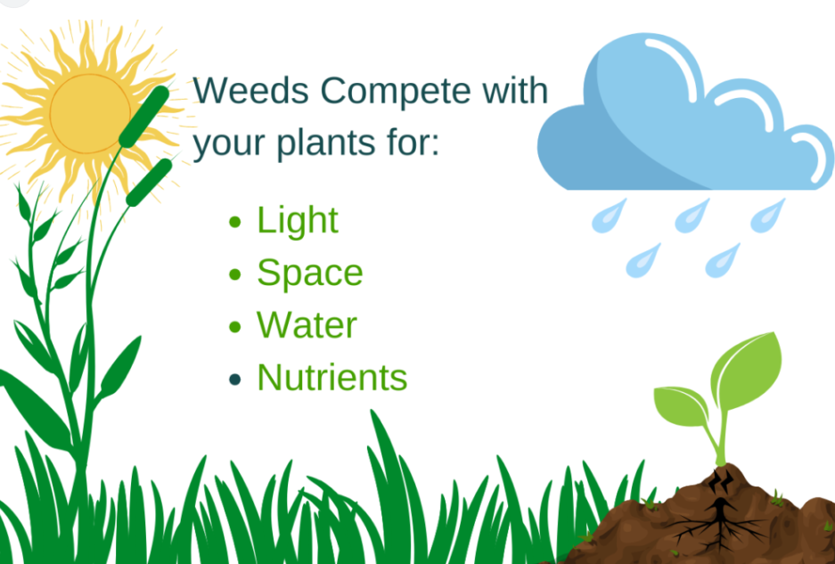
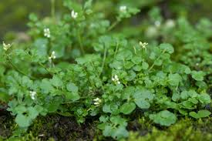

Slide 21
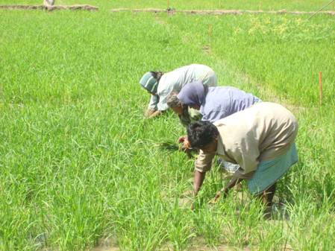
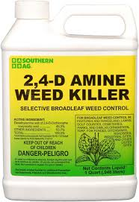
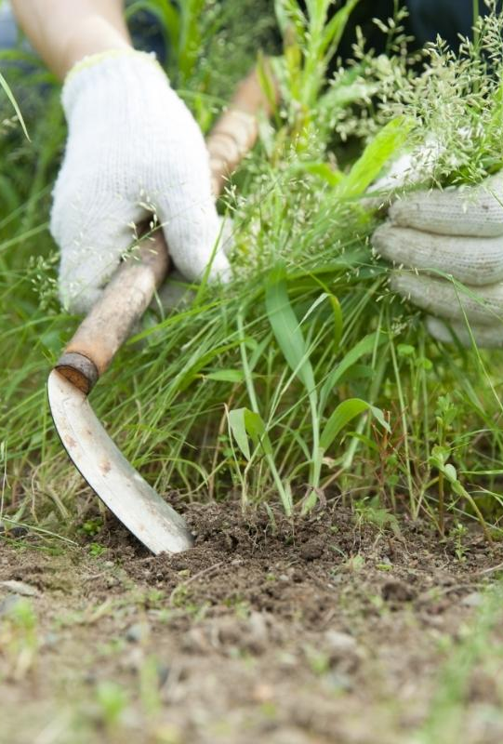
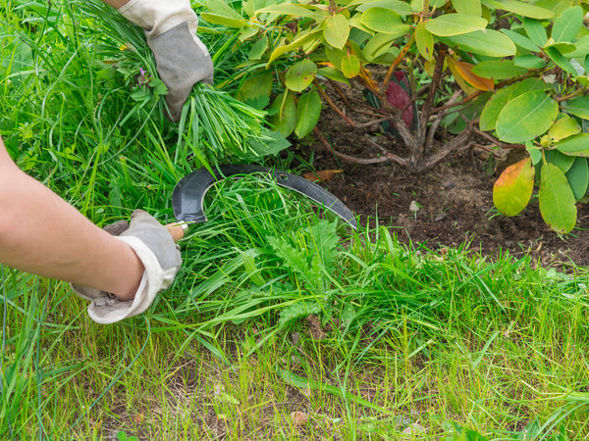

Slide 22
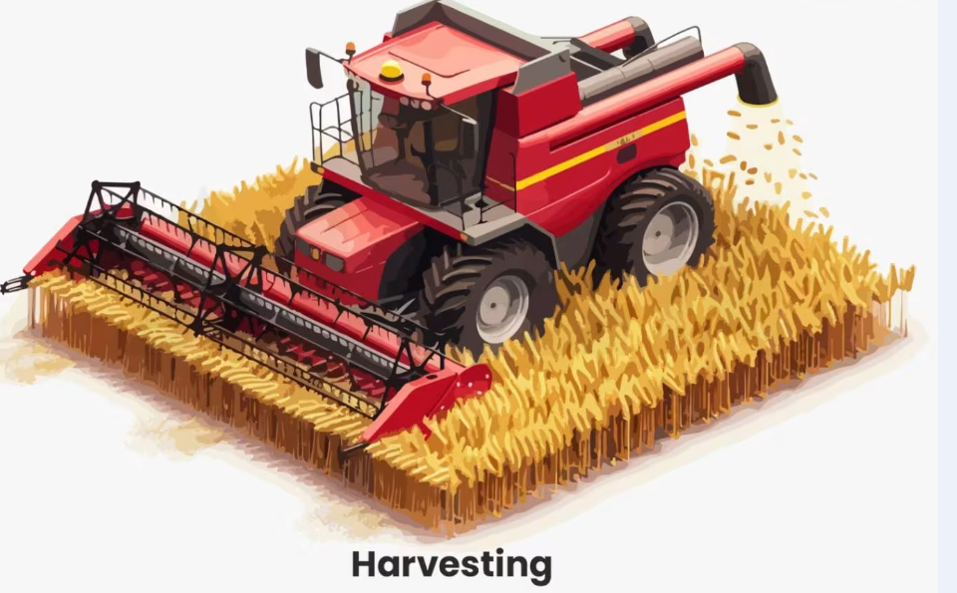
HARVESTING
Harvesting : The cutting and gathering of crops after its maturation is called harvesting. It can be done manually by sickle or by a machine called a harvester

Slide 23
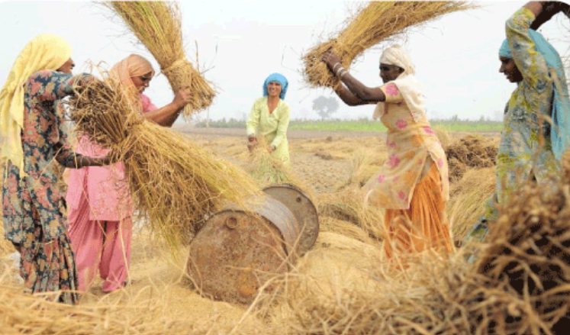
THRESHING
Threshing
Threshing is the process of loosening the grains from the chaff.
While it can be done manually, a machine is used that separates all the grain seeds these days.

Slide 24
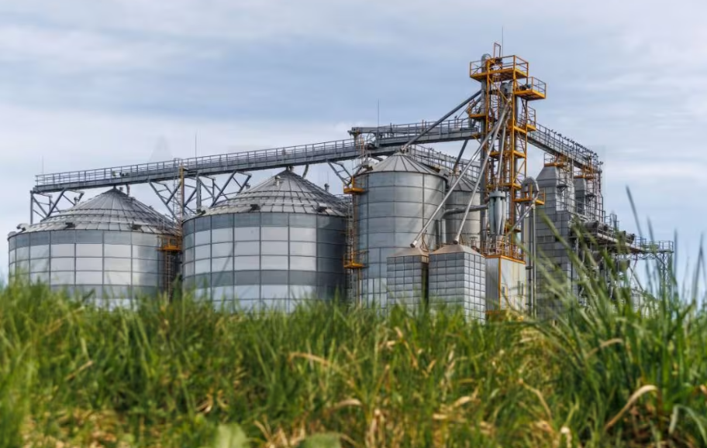
STORAGE OF GRAINS
Storage : Proper storage is necessary to get seasonal food regularly throughout the year. Freshly harvested grains have more moisture. If freshly harvested grains are stored without drying, then they may get spoil and loose their germination capacity Storage losses can be very high.
Factors contributing to losses are biotic components such as fungi, mites, bacteria, insects, rodents etc.
Abiotic components that affect storage losses include un favourable temperatures, improper storage techniques, etc. It can cause the following:
Degraded quality of food
Poorly germinated seeds
A loss in weight of crops
Dis coloured produce

Slide 25
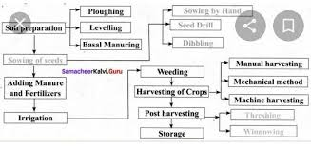
MIND MAP

Slide 26
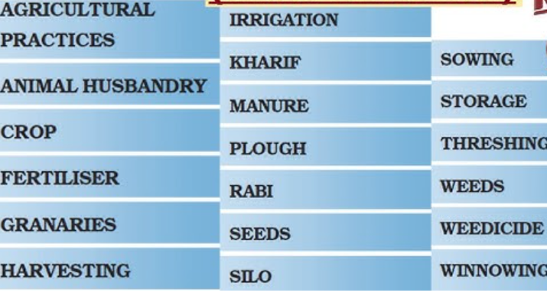
KEY WORDS

Slide 27
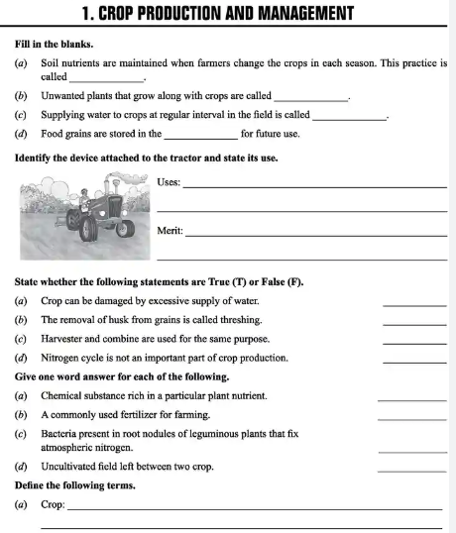

Slide 28
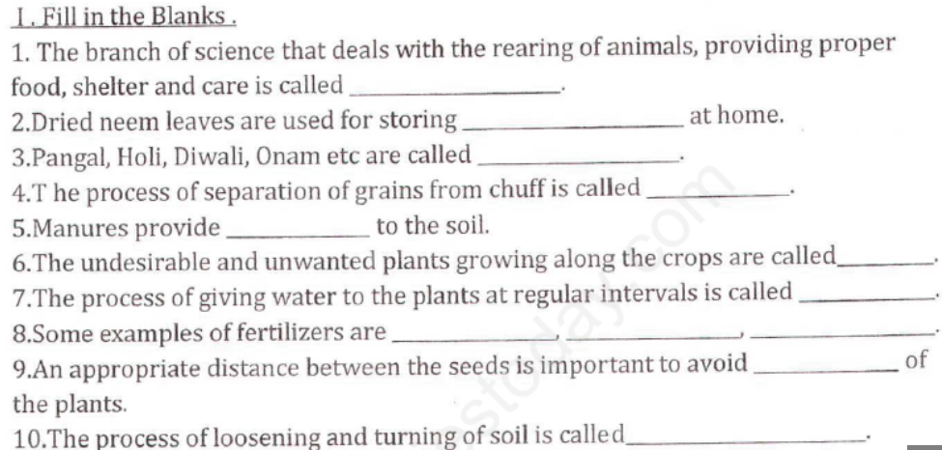

Slide 29
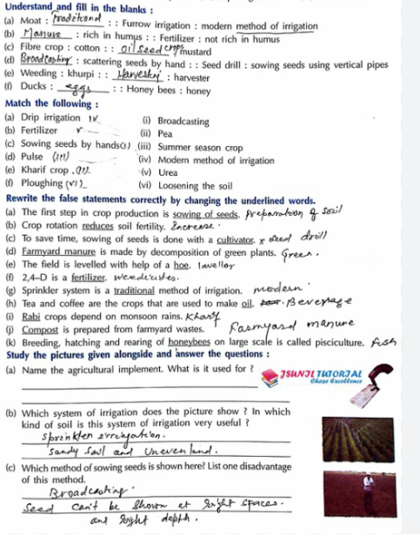

Slide 30
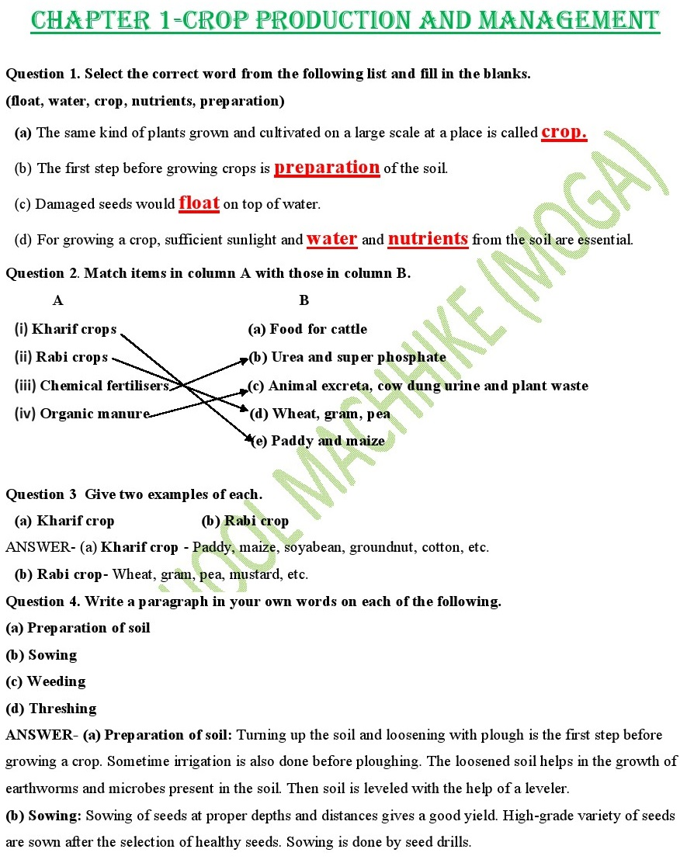

Slide 31


